Slide 1
Phase-8 The Testing and Validation roadmap
Supervised by:
Dr. Sabah Mohammad

Slide 2
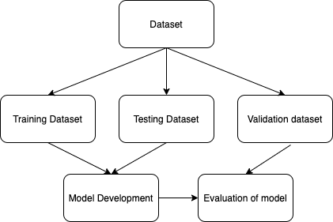
Model Testing:
The dataset will be divided into different dataset like training, testing and validation.
There are different metrics for evaluation of the model
Accuracy
Loss etc

Slide 3
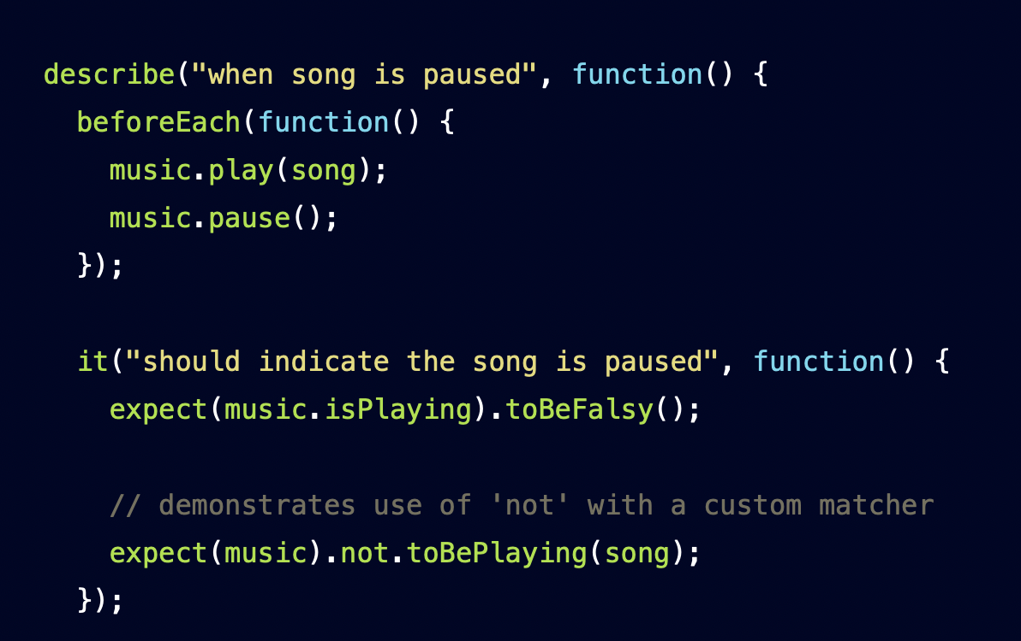
Mobile App testing:
The mobile app can be tested in many ways such as screen testing, functionality testing, unit testing etc.
There are testing libraries like reactnative-testing library & jest for testing a mobile app.
There are open source frameworks like Appium for testing the mobile apps.
The scripts are written with expected behaviour in which the testing gives whether the expected behaviour is observed or not.

Slide 4
THANK YOU

